Slide 1
3.4 Advances Structures

Slide 2
Objectives
Learn how structures can be used within functions
Learn to pass and return structures
Learn to pass structures using pointers

Slide 3
Agenda
Sending individual members of structures in a function
Sending the whole structure in a function
Passing structures through pointers in a function

Slide 4
Structures and Functions
For structures to be fully useful, we must be able to pass them to functions and return them.
Function can access the members of a structure in 3 ways:
Individual members can be passed to the function
The whole structure can be passed and the function can access the members using pass by value
The address of a structure or a member can be passed and the function can access the members through indirection and selection operators ( pass by address)

Slide 5
Sending Individual Members
We can pass the individual members in a structure through functions the same way we pass normal parameters.
The only difference is you must use the member operator to refer to the individual members for the actual parameters

Slide 6
Sending Individual Members Contd..
Let us learn how to pass structures using an example.
Consider a structure as shown below:
Our aim is to pass the numerator and denominator as arguments in a function called multFr which multiplies the corresponsding numerators and denominators, ie, multiply fractions.
struct FractionNumber
{
int numerator;
int denominator;
}fr1,fr2;

Slide 7
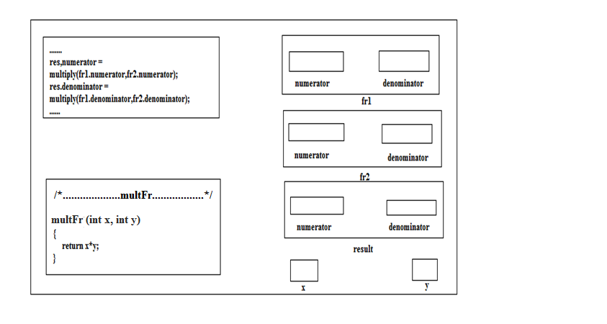
Sending Individual Members
Sending individual members to a function is no different
Below fig.1 is a simple example to multiply two fractions
The structure mentioned in the previous slide is considered
Passing numerator and denominator in the function multFr
Fig 1
Function multFr definition

Slide 8
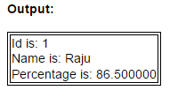
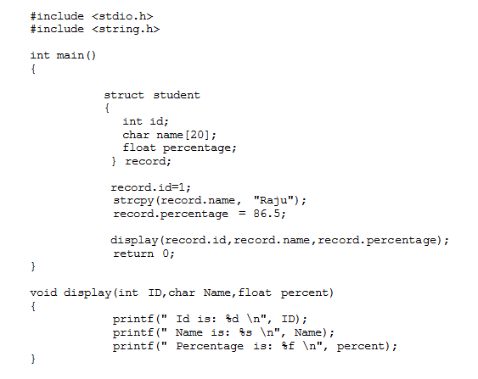
Another Example
Function pass
Function Definition

Slide 9
Sending the Whole Structure
Pass entire structure and let multFr complete its job in one call.
While passing a structure, specify the type in the formal parameters of the called function.
While returning a structure, specify the structure as the return type in the called function.
Pass by value is used.
This may lead to some inefficiencies when large structures are used since when we pass a structure to a function, C will copy the values to the local structure just as it does for variables.
The function call will be as multFr(fr1,fr2)
The function declarqtion will be as
multFr(struct FractionNumber f1, struct FractionNumber f2);

Slide 10
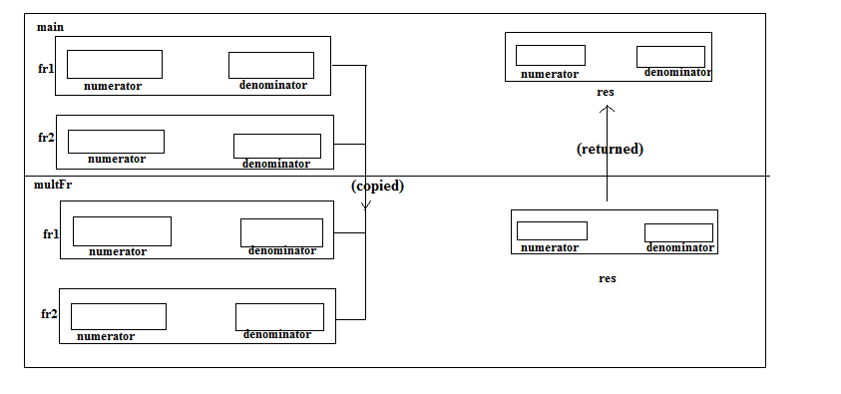
Sending the Whole Structure
Fig 2 shows the previous example of multiplying two fractional numbers by passing the entire structure.
The same structure FractionNumber used in the previous example is considered.
The figure below illustrates how call by value is functioned here.
Fig 2

Slide 11
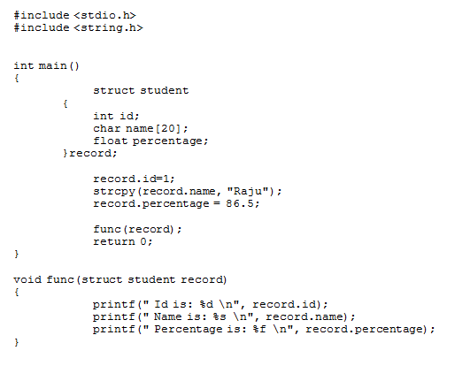
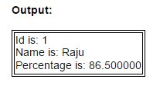
Another Example
F
Function Call
Function Definition

Slide 12
Passing Structures through Pointers
It is more efficient to pass structures through pointers especially when the structures are large and the function is frequently used.
Also it is common to pass structure through pointers when the structure is in dynamic memory.
We modify the multiply fractions example once more to pass the structures using pointers.
The modified memory flow diagram is shown in Fig.3 in the next slide.

Slide 13
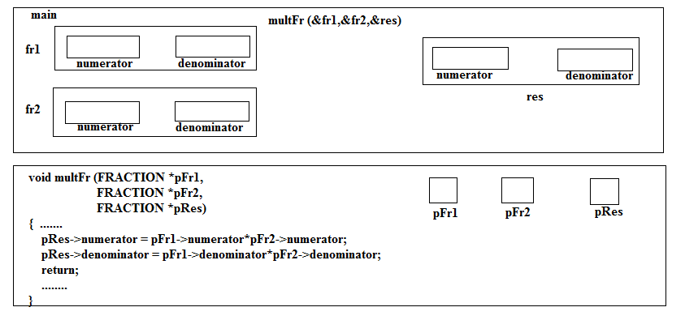
Passing Structures through Pointers
The same structure FractionNumber is considered in this example.
pFr1, pFr2 and pRes are pointers to fr1,fr2 and res
Fig 3
Function definition

Slide 14
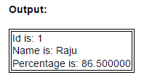
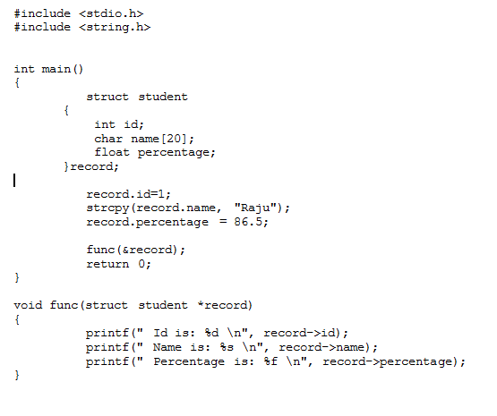
Another Example

Slide 15
How to pass an array of structures?
Assume a structure as follows:
struct Items
{ char code[10];
char description[30];
int stock; };
struct Items MyItems[10];
Option 1:
int main(void)
{ struct Items MyItems[10];
ReadFile(MyItems);
}
This is generally not used as it is dangerous of course since ReadFile has no idea how big the array is (arrays are alwayspassed by decay-to-pointer). So you would typically add this information:

Slide 16
How to pass an array of structures? (Contd..)
Option 2:
You pretty much have to use pointers for this.
Your function would look like this:
void ReadFile(Items * MyItems, int numberOfItems)
You need to use pointer to array, after that it is easy to access its members

Slide 17
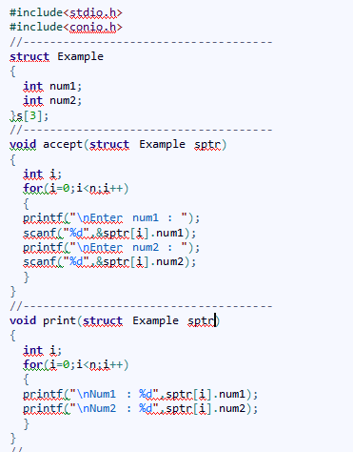
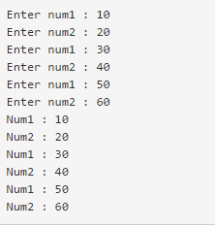
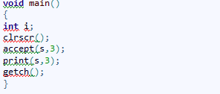
An Example for Option 1
Output

Slide 18
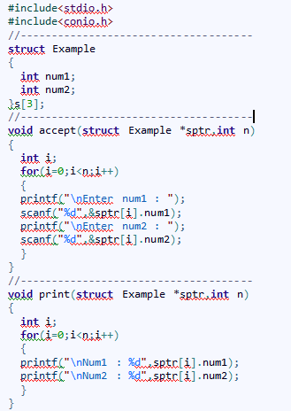
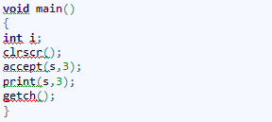
An Example for Option 2
Instead of ‘*sptr’ , ‘sptr[]’ can also be used
Output

Slide 19

Try it Yourself
A structure marks contain marks of 3 subjects. Use a function average to calculate the average marks of students. Assume the number of students to be 3. Write a program to implement this using the following techniques:
Sending individual members
Sending the whole structure
Passing structures through pointers

Slide 20
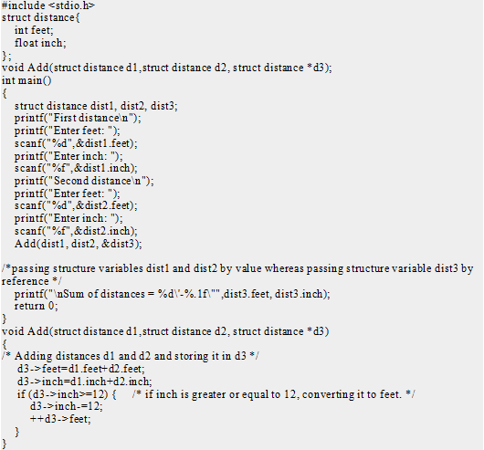
Predict the output
Notes:
Output
First distance
Enter feet: 12
Enter inch: 6.8
Second distance
Enter feet: 5
Enter inch: 7.5
Sum of distances = 18'-2.3“
Explanation
In this program, structure variables dist1 and dist2 are passed by value (because value of dist1and dist2 does not need to be displayed in main function) and dist3 is passed by reference ,i.e, address of dist3 (&dist3) is passed as an argument. Thus, the structure pointer variable d3 points to the address of dist3. If any change is made in d3 variable, effect of it is seed in dist3 variable in main function.

Slide 21
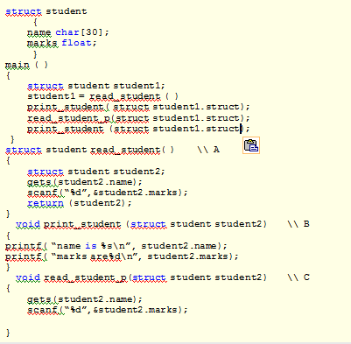
Predict the error
Notes:
Answer:
print_student (student1);
read_student_p(student1);
print_student(student1);

